Slide 1
Chapter 3: Information Representation
Logic & Arithmetic Operators
Notes:
In this presentation, logic and arithmetic operators that are used at the binary level are discussed. These are significant because they will be available as instructions in the CPU.
Let’s look at them.

Slide 2
Logical Operators
Boolean algebra is a mathematical system for the manipulation of variables that can have one of two values
Formal logic: “true” and “false”
Digital systems:
“on” and “off”
1 and 0
“high” and “low”
Boolean expressions are created by performing operations on Boolean variables
Common Boolean operators include:
AND, OR, and NOT
Notes:
Boolean algebra is a mathematical system for the manipulation of variables that can have one of two values.
In formal logic, these values are “true” and “false.”
In digital systems, these values are “on” and “off,” 1 and 0, or “high” and “low.”
Boolean expressions are created by performing operations on Boolean variables.
Common Boolean operators include AND, OR, and NOT.

Slide 3
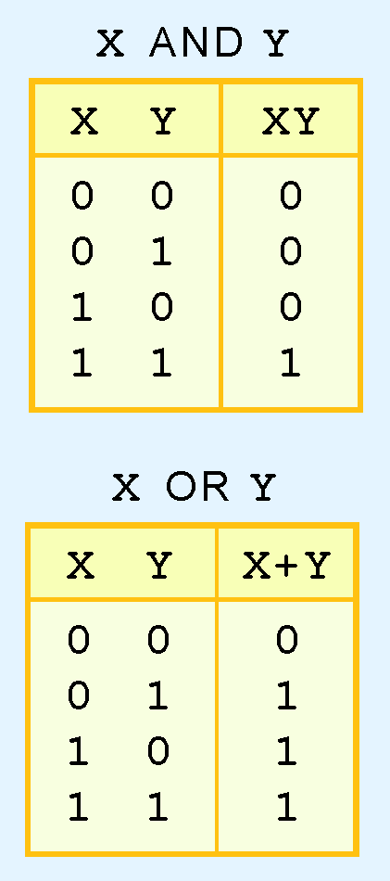
Boolean Algebra
Boolean operator described with truth table
Truth table for AND and OR are shown at right
AND operator is the Boolean product
OR operator is the Boolean sum
Notes:
A Boolean operator can be completely described using a truth table.
The truth table for the Boolean operators AND and OR are shown at the right.
The AND operator is also known as the Boolean product. The OR operator is the Boolean sum.

Slide 4
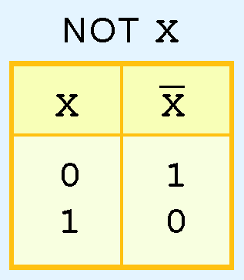
Boolean Algebra
Truth table for the Boolean NOT operator is shown at the right
NOT operation is often designated by an overbar
sometimes indicated by a prime mark ( ‘ )
sometimes an “elbow” (¬).
Notes:
The truth table for the Boolean NOT operator is shown at the right.
The NOT operation is most often designated by an overbar. It is sometimes indicated by a prime mark ( ‘ ) or an “elbow” (¬).

Slide 5
Boolean Algebra
A Boolean function has:
At least one Boolean variable,
At least one Boolean operator, and
At least one input from the set {0,1}
Output is also a member of the set {0,1}
Another reason why the binary numbering system is so handy in digital systems.
Notes:
A Boolean function has:
At least one Boolean variable,
At least one Boolean operator, and
At least one input from the set {0,1}.
It produces an output that is also a member of the set {0,1}.
This is another reason why the binary numbering system is so handy in digital systems.

Slide 6
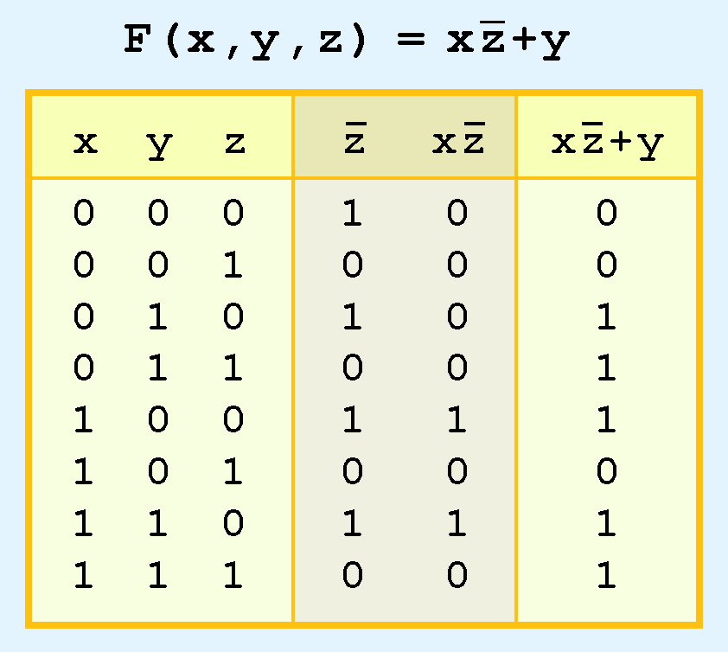
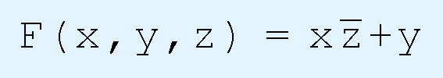
Boolean Algebra
Truth table for the Boolean function:
is shown at the right.
Extra (shaded) columns hold evaluations of subparts of function
Notes:
Truth table for the Boolean function:
F of x,y,x equals x and not z or y
is shown at the right.
To make evaluation of the Boolean function easier, the truth table contains extra (shaded) columns to hold evaluations of subparts of the function.

Slide 7
Boolean Algebra
Boolean operations have rules of precedence
NOT operator has highest priority
AND
OR
This determined the (shaded) function subparts in table
Notes:
As with common arithmetic, Boolean operations have rules of precedence.
The NOT operator has highest priority, followed by AND and then OR.
This is how we chose the (shaded) function subparts in our table.
Hopefully you have used Boolean algebra and Truth Tables before as they will be very helpful in determining number representation and the operations that happen to them at the assembly code level.

Slide 8
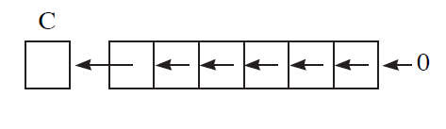
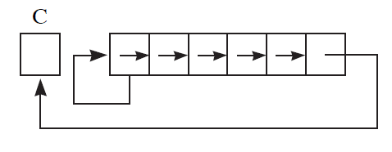
Arithmetic Operators
ASL – arithmetic shift left
Effectively multiplies by 2 ( if no carry)
ASR – arithmetic shift right
Effectively divides by 2 (sign bit stays the same)
Notes:
An arithmetic shift left, shifts each bit left into the next column. The leftmost bit is shifted into the carry bit. The right most bit is filled with 0.
This effectively multiplies the number by 2 – remember each column represents a power of 2. If the carry bit receives a 1 – and must be addressed.
An arithmetic shift right, shifts each bit right into the next column. The left most bit remains the same and the right most bit is shifted into the carry bit. This is designed specifically for two’s complement representation. Because the sign bit doesn’t change positive number stay positive and negative numbers stay negative. This effectively divides the number by 2.

Slide 9
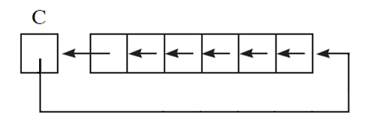
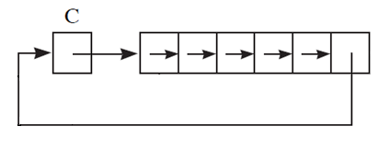
Arithmetic Operators
ROL – rotate left
ROR – rotate right
Notes:
The arithmetic shifts interpret the binary sequence as an integer. The rotate operations do not. The rotate operators rotate through the carry bit as shown.
These logical and arithmetic operations are used for manipulating binary numbers at a very basic level and they are the basis for all of the higher level math functions that we use every day.

